Slide 1
Component Modules of DBMS

Slide 2
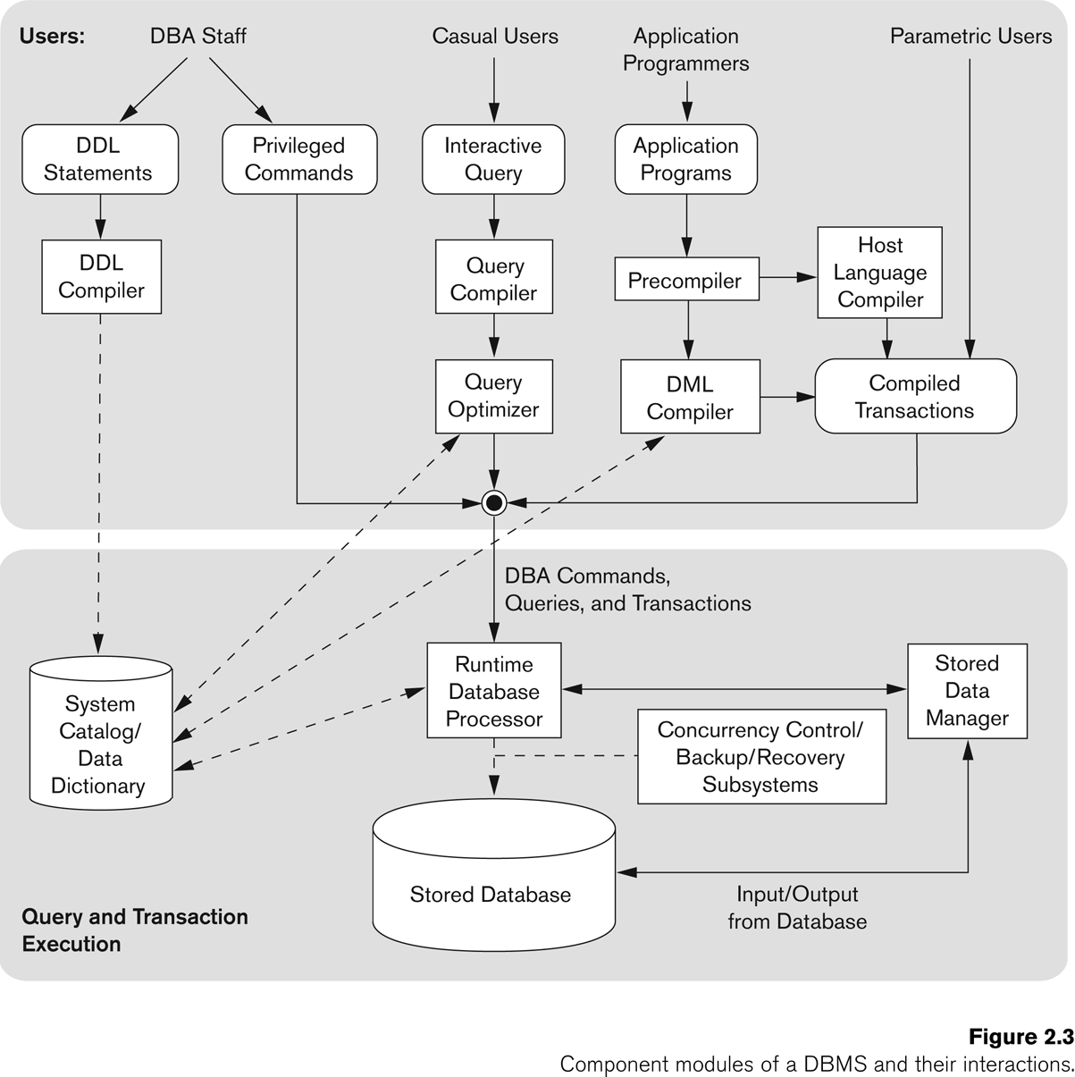

Slide 3
A database system being a complex software system is partitioned into several software components that handle various tasks such as data definition and manipulation, data security and integrity, data recovery and concurrency control, and performance optimization

Slide 4
Data definition:
DBMS provides functions to define the structure of the data.
functions include defining and modifying the record structure, the data type of fields, and the various constraints to be satisfied by the data in each field.
It is the responsibility of database administrator to define the database, and make changes to its definition (if required) using the DDL and other privileged commands.
The DDL compiler component of DBMS processes these schema definitions, and stores the schema descriptions in the DBMS catalog (data dictionary). Other DBMS components then refer to the catalog information as and when required.

Slide 5
Data manipulation
Once the data structure is defined, data needs to be manipulated. The manipulation of data includes insertion, deletion, and modification of records. The functions that perform these operations are also part of the DBMS.

Slide 6
The queries that are defined as a part of the application programs are known as planned queries.
The application programs are submitted to a precompiler, which extracts DML commands from the application program and send them to DML compiler for compilation.

Slide 7
The rest of the program is sent to the host language compiler.
The object codes of both the DML commands and the rest of the program are linked and sent to the query evaluation engine for execution.

Slide 8
The sudden queries that are executed as and when the need arises are known as unplanned queries (interactive queries). These queries are compiled by the query complier, and then optimized by the query optimizer.
The query optimizer consults the data dictionary for statistical and other physical information about the stored data. The optimized query is finally passed to the query evaluation engine for execution.

Slide 9
The naive users of the database can also query and update the database by using some already given application program interfaces. The object code of these queries is also passed to query evaluation engine for processing.

Slide 10
Data security and integrity:
The DBMS contains functions, which handle the security and integrity of data stored in the database. Since these functions can be easily invoked by the application, the application programmer need not code these functions in the programs.

Slide 11
Concurrency and data recovery:
The DBMS also contains some functions that deal with the concurrent access of records by multiple users and the recovery of data after a system failure

Slide 12
Performance optimization:
The DBMS has a set of functions that optimize the performance of the queries by evaluating the different execution plans of a query and choosing the best among them.

